Slide 1
BACKGROUND OF THE STUDY
Research on Connected and Automated Vehicular driving have been centered around perception, planning and control ((Zhu, Chen, & Xiong, 2017))
This work focuses on planning which is aims to provide a safe and collision-free path for vehicles towards their destinations by accounting for comfort (minimum bending energy), maneuvering capabilities, vehicle dynamics in the presence of obstacles, traffic rules and road boundaries (Zhang et al. 2013)
The path planning problem will progress on the work of (Hu et al., 2017) which defined path candidates’ center line construction based on a parametric cubic spline.
This research project will focus on the path planning aspect of the planning problem for autonomous driving.

Slide 2
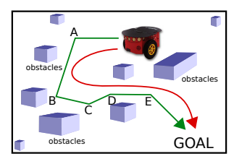
MOTIVATION AND DIRECTION
Claussmann et.al. (2020) classified path planning algorithms according to space configuration, pathfinding, attractive & repulsive forces, parametric & semi-parametric curves, numerical optimization and artificial intelligence.
In this work, a two-step approach will be utilized in identifying an optimal trajectory by firstly using the pathfinding algorithms.
In addressing the challenges of sharp turns undesirable for CAV
motion, a form of the parametric curves algorithms is utilized as the
second step to generating a smooth and desirable motion path.
Bezier curves are selected as the parametric curves for path smoothening due to their ease of implementation, low computation cost and applications for ride comfort (Chen et.al. (2017)).
Fig 1: Straight (Green) and smooth (Red) paths in Ravankar, et al., 2018

Slide 3
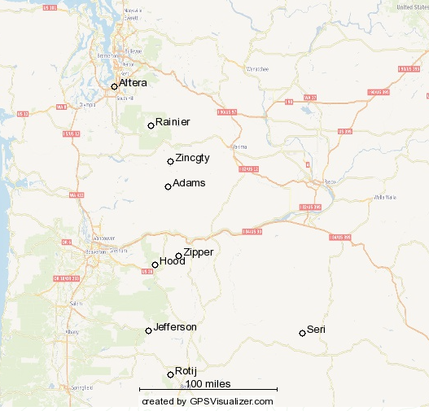
Optimal trajectory
Problem Formulation
Consider a geodesic problem detailed on the map on the right. The
goal is to find the shortest and smoothest path from Altera (node 0)
to Rotij (node 8) for an autonomous vehicle.
The dynamic programming method for obtaining the shortest path
for this problem is below:

Slide 4
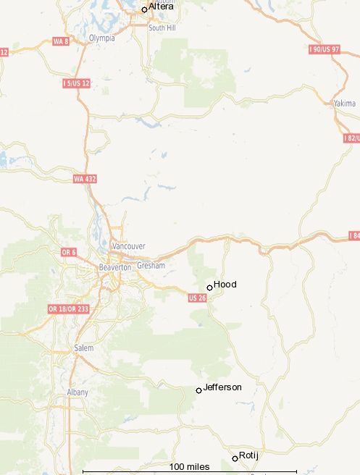
Shortest path
Result
Shortest path:
Node 0 (Altera) 5 6 Node 8 (Rotij)
Path length: 4.789
The second step will be to smoothen this path to achieve desired CAV
motion and avoid sharp turns.

Slide 5
PATH SMOOTHENING
A Bezier curve is used for the path smoothening step while avoiding the numerical instability of larger control points (higher degree Bezier curves) and satisfying the path planning requirement by at least utilizing the recommended least degree of Bezier curve suggested by Elkaim & Choi (2008).
Hence a 3-degree (cubic) Bezier curve with 4 control points is used with details below:
Generally, a Bezier curve of degree d is of the form:
For degree 3 (cubic Bezier);

Slide 6
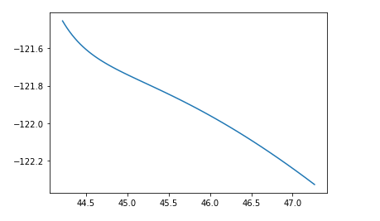
PATH SMOOTHENING
Results
For the cubic Bezier curve applied to the shortest path obtained while selecting nodes 5 & 6 as control points, the smoothened path is on the left:
Python 3.6 used to code and generate shortest path and Bezier curves

Slide 7
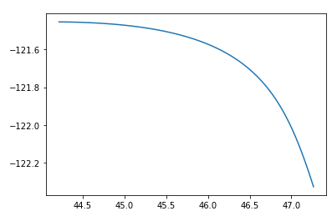
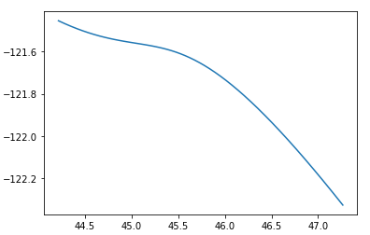
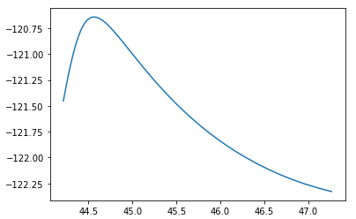
SENSITIVITY ANALYSIS & PERFORMANCE
Sensitivity Analysis of Control Points selection
Control points were selected based on proximity to the start node (0), map midpoint and the destination node (8). The respective graphs are below:
Control points selected (Left to right): (a) closer to start node 0 (b) closer to map midpoint (c) closer to destination node 8

Slide 8


SENSITIVITY ANALYSIS & PERFORMANCE
Performance Measures
The quality of selection of control points was measured by the minimization of curve arc length and the bending energy (measure of spread of curvature uniformly over the curve).
Arc length is denoted as:
Bending Energy, E as stated in Eberly (2010) is:

Slide 9
CONCLUSION & FUTURE DIRECTION
Conclusion
The shortest path method generated the path that most minimized arc length (3.1868) while selecting control points closer to the midpoint generated the path with the least bending energy and most convenient for CAV motion traversal.
Future Direction
This project focused on path smoothening on a 2D plane. It can be extended further to surfaces.
While the degree of Bezier curve used for path smoothening is important, the problem of selecting control points that can minimize arc length and bending energy, requires an optimal approach.

Slide 10
REFERENCES
Chen, J., Zhao, P., Mei, T., & and Liang, H. (2013). Lane change path planning based on piecewise bezier curve for autonomous vehicle. Proceeding of IEEE International Conference of Vehicles Electronic Safety (ICVES), 17-22.
Choi, J.-W., & Elkaim, G. H. (2008). Bezier Curve for Trajectory Guidance. World Congress on Engineering and Computer Science.
Claussmann, L., Revilloud, M., Gruyer, D., & Glaser, S. (2020, May). A Review of Motion Planning for Highway Autonomous Driving. IEEE TRANSACTIONS ON INTELLIGENT TRANSPORTATION SYSTEMS, 21.
Eberly, D. (2010). A Relationship Between Minimum Bending Energy and Degree Elevation for Bezier Curves. Redmond, WA, United States. Retrieved from https://www.geometrictools.com/
Hu, X., Chen, L., Tang, B., Cao, D., & He, H. (2017). Dynamic path planning for autonomous driving on various roads with avoidance of static and moving obstacles. Mechanical Systems and Signal Processing, 482-500.
Zhang, S., Deng, W., Zhao, Q., Sun, H., & Litkouhi, B. (2013). Dynamic Trajectory Planning for Vehicle Autonomous Driving . IEEE International Conference on Systems, Man and Cybernetics, 4161-4166.
Zhu, M., Chen, H., & Xiong, G. (2017). A Model Predictive Speed Tracking Control Approach for Autonomous Ground Vehicles. Mechanical Systems Signal Process, 138-152.
Ziegler, J., Bender, P., Schreiber, M., Lategahn, H., Strauss, T., Stiller, C., . . . Keller, C. G. (2014). Making bertha drive-an autonomous journey on a historic route. IEEE Intelligence Transport System Management, 6, 8-20.

